Slide 1

2019 90-90-90 Targets
France progress and experience
François Dabis, MD, PhD
Mexico (07/19) 1

Slide 2
Data sources to estimate the cascade
Health Insurance data
Cohorts of HIV patients in care
Cohorts of HIV patients
in population
Individuals diagnosed with HIV,
linked to care and followed-up
Individuals diagnosed with HIV but not linked to care
Undiagnosed HIV infections
Data on newly diagnosed HIV cases

Slide 3
Data sources to estimate the cascade
+ modeling to provide estimates
Health Insurance data
Cohorts of HIV patients in care
Cohorts of HIV patients
in population
Individuals diagnosed with HIV,
linked to care and followed-up
Individuals diagnosed with HIV but not linked to care
Undiagnosed HIV infections
Data on newly diagnosed HIV cases

Slide 4
Cascade of care in France in 2016
∼ 173 000 individuals living with HIV
Source: ANRS & Santé Publique France
86%
88%
97%

Slide 5

« Good » cascade of care in France in 2016
UNAIDS target
→ 73% VL<200 cp/ml
86%
76%
74%
86%
88%
97%

Slide 6
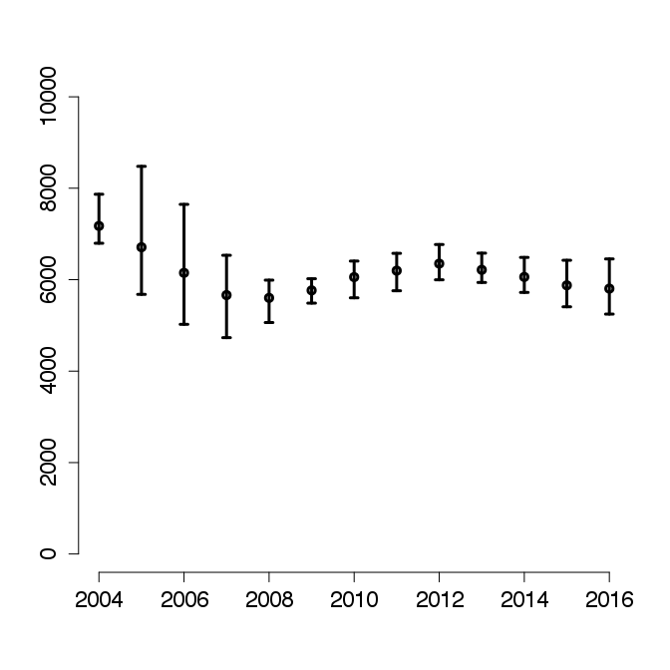
Good cascade…
… but stable incidence,
Estimated number of new HIV infections
2004-2016
Source: ANRS & Santé Publique France
5800
Notes:
À l’oral Why?
Because coverage of HIV prevention is not high enough and time from HIV infection to ART initiation is long, thus undiagnosed epidemic (dire chiffre pour 2016)

Slide 7
Good cascade…
… but stable incidence,
& long time interval infection - diagnosis
Median times in years
between infection and diagnosis
(2014-2016)
Estimated number of new HIV infections
2004-2016
<0.1
0.2
5800
3.3
0.3
Notes:
À l’oral Why?
Because coverage of HIV prevention is not high enough and time from HIV infection to ART initiation is long, thus undiagnosed epidemic (dire chiffre pour 2016)

Slide 8
Long time interval between infection and diagnosis in France in 2014-2016
Source: ANRS & Santé Publique France
Median time between infection and diagnosis: 3.3 years
>4 years for heterosexual men (whether born in France or abroad)
<3 years for MSM and heterosexual women (whether born in France or abroad)
Notes:
À l’oral Why?
Because coverage of HIV prevention is not high enough and time from HIV infection to ART initiation is long, thus undiagnosed epidemic (dire chiffre pour 2016)

Slide 9
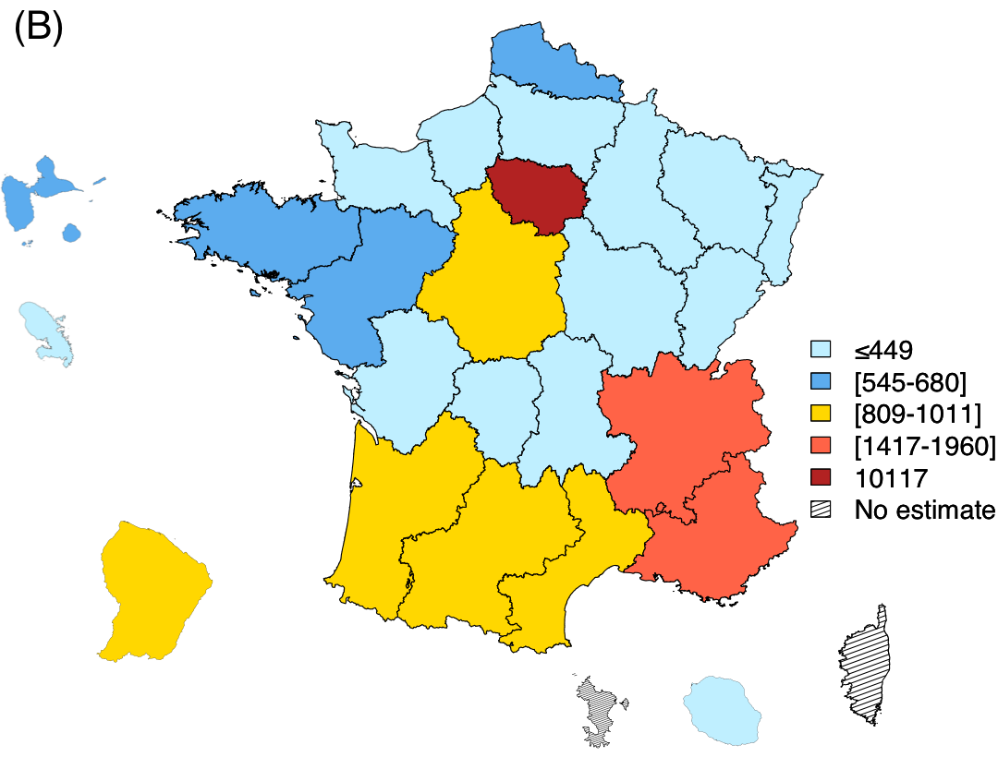
Geographic heterogeneity:
Estimated number of undiagnosed HIV infections
by administrative region
Centre
MSM, SSA-born heterosexual women
Paris region
Born-abroad MSM, MSM born in France, SSA-born heterosexual (women & men)
French Guyana
PACA
Born-abroad MSM,
MSM born in France
Born-abroad heterosexual men
Born-abroad heterosexual women
Marty, Cazein, Panjo, Pillonel, Costagiola, Supervie, HERMETIC study group (2018)
https://onlinelibrary.wiley.com/doi/10.1002/jia2.25100
Notes:
60% in Centre
80% in Paris
44% in PACA
68% in Guyane
Affected population varies from on region ot another, shwoing the importance of subnational estimates

Slide 10
Long time interval between infection and diagnosis in France in 2014-2016
Our challenge :
Reduce entry into the cascade
Improve the 1st 90 overall
Fix disparities between vulnerable populations and between regions
Notes:
À l’oral Why?
Because coverage of HIV prevention is not high enough and time from HIV infection to ART initiation is long, thus undiagnosed epidemic (dire chiffre pour 2016)

Slide 11
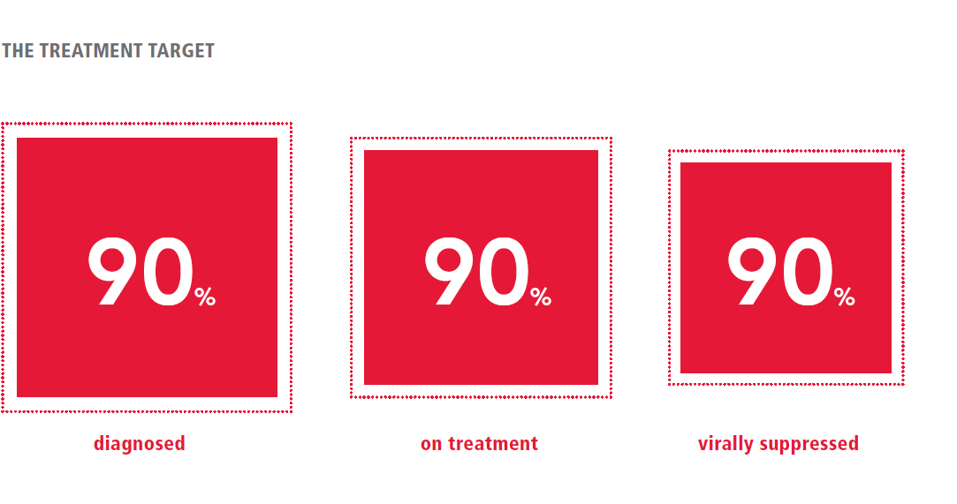
The 4th 90 : good quality of life
90%
good quality of life
Lazarus et al., BMC Med, 2016

Slide 12




The ANRS CO3 Aquitaine Cohort’s
« Bring your own device » solution
1. PLWH create their own accounts
Prompt 1x per year
2. Complete an initial battery of PRO
Q
Q
Q
Q
Q
Collection of “patient-reported outcomes”
12 years of follow-up on average
Enrollment in the QuAliV Study
Collection of routine clinical and laboratory data
Enrolled in the ANRS CO3 Aquitaine Cohort
Barger et al., JMIR Research Protocol, 2018

Slide 13
Acknowledgements
Dominique Costagliola, Virginie Supervie
Diana Barger, Fabrice Bonnet, ANRS CO3 cohort

Slide 14

francois.dabis@anrs.fr
@DabisFrancois

